Slide 1
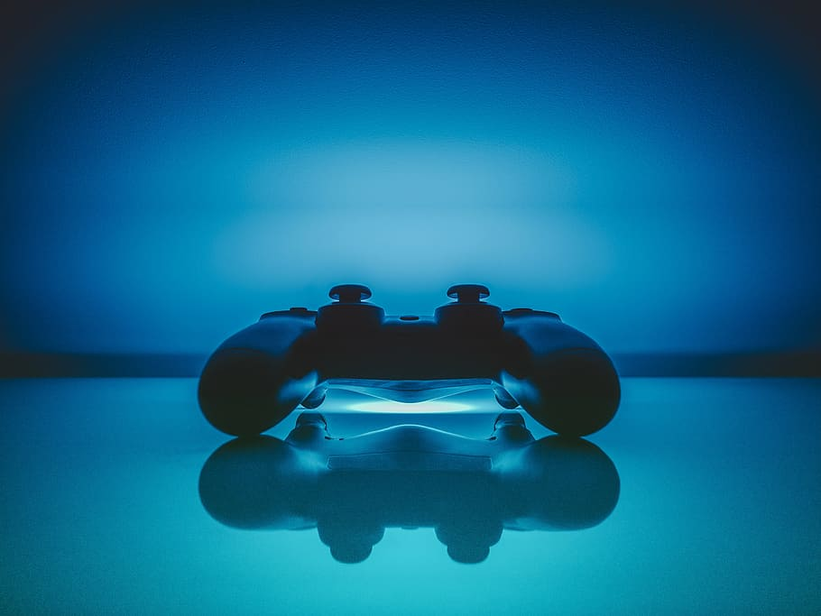


Gaming and Mental Health
Ian Arch, Paige Breyfogle, Daniel Buescher,
J.A. Gorman, Andrew Stepanek

Slide 2

Does gender play a role?
How?
Does the way video games are played correlate to the state of one’s mental health?

Slide 3

Our Data
The original data was taken from 14.3k people in over 100 countries.
Our data narrows down the focus to the top six countries in the set:
USA
Germany
UK
Canada
Netherlands
France
The mental health questions were focused on anxiety, social phobias, and life satisfaction
Other questions included gaming style and motivations, as well as gender, where they are from, and other identifying criteria
Notes:
“This dataset consists of data collected as a part of a survey among gamers worldwide. The questionnaire asked questions that psychologists generally ask people who are prone to anxiety, social phobia, and less to no life satisfaction. The questionnaire consists of several set of questions as asked as a part of psychological study. The original data was collated by Marian Sauter and Dejan Draschkow.”The file consists of 55 columns that correspond to every question asked in the questionnaire. Most of the columns correspond to different scoring criteria used in psychology like GAD (General Anxiety Disorder), SWL (Satisfaction with Life) an and SPIN (Social Phobia Inventory) scores. There are a few generic questions about where the people are born and why do they lay online games etc.

Slide 4

What games are we playing….
and how long are we playing for?

Slide 5

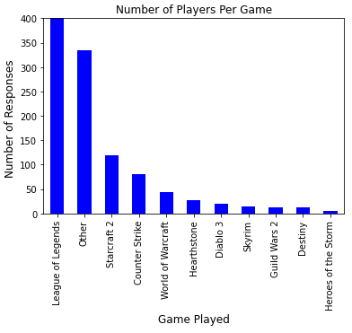
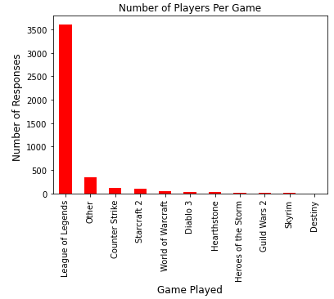
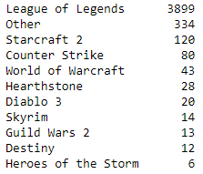
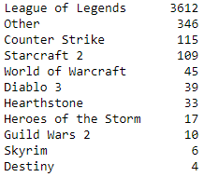
Popular within the US
Popular outside the US

Slide 6

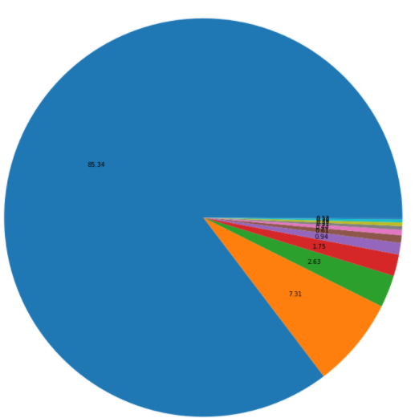
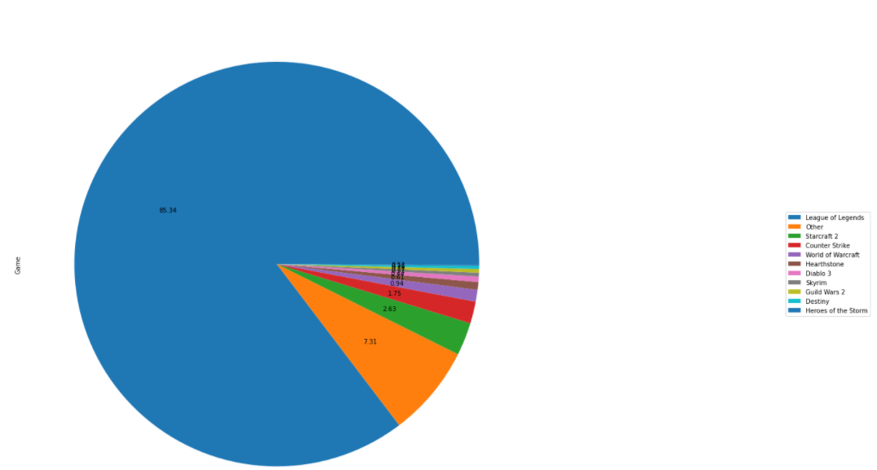
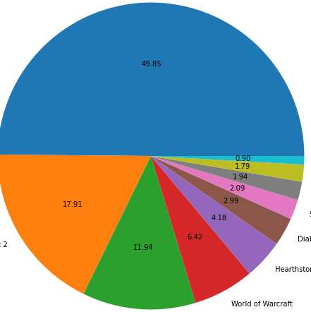
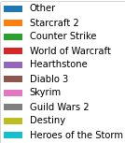
With League of Legends
Without League of Legends
Popular within the US

Slide 7
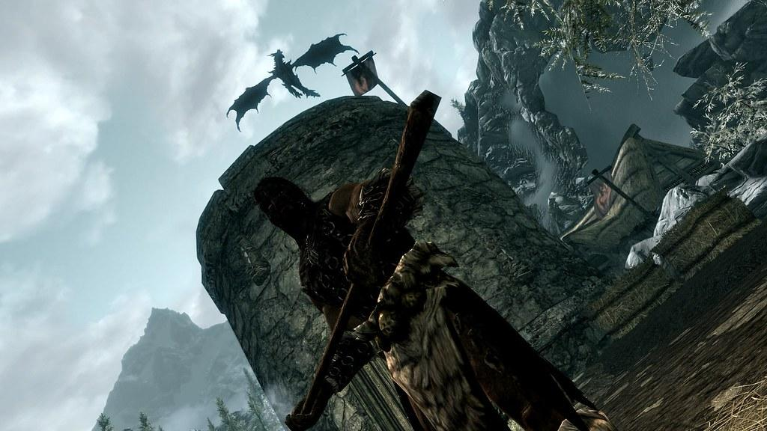
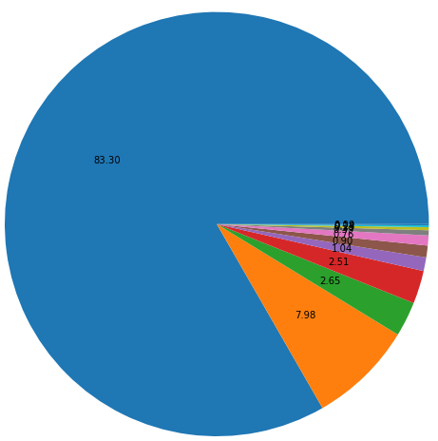
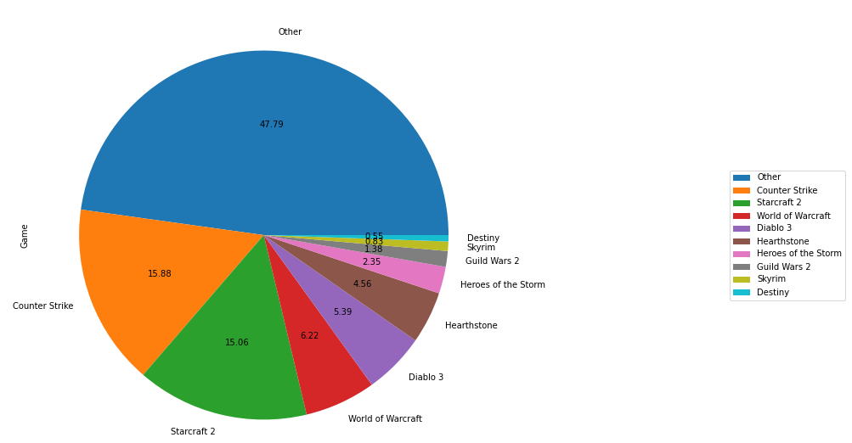
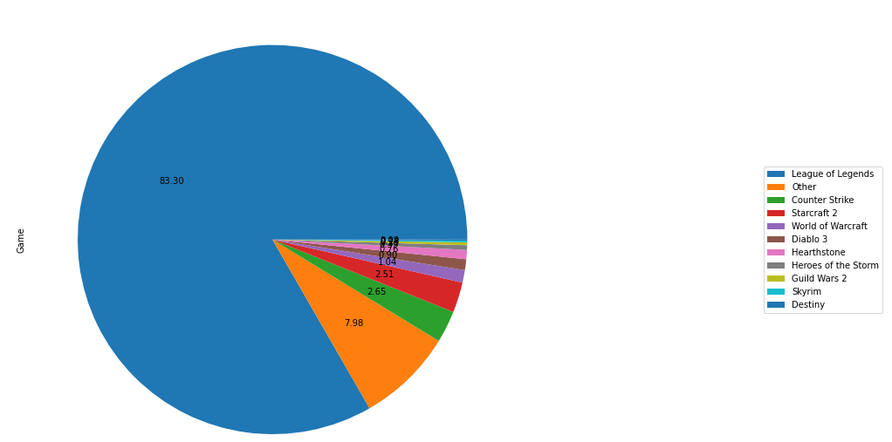
With League of Legends
Without League of Legends
Popular outside the US

Slide 8

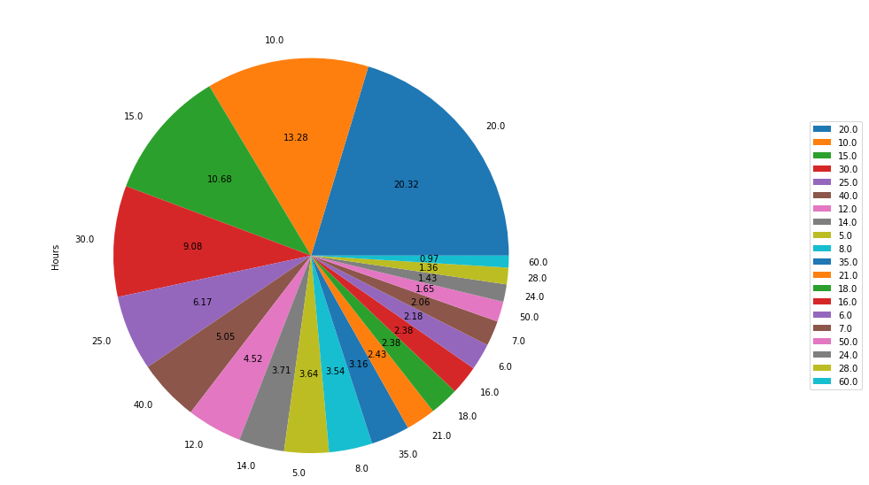
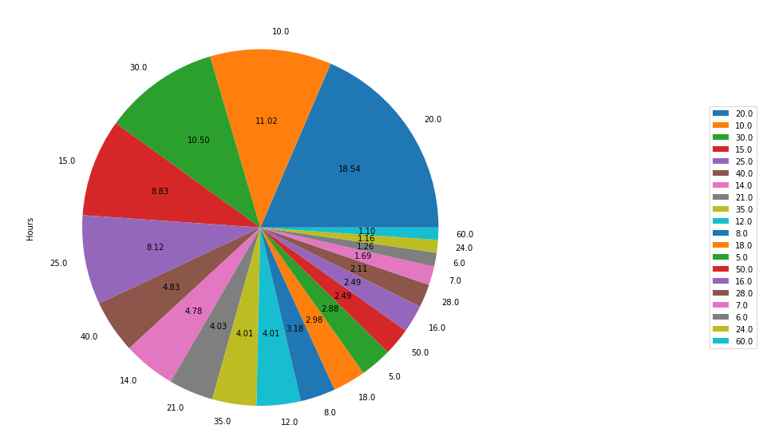

Time Spent
in Video Games
TIME PLAYED IN USA
TIME PLAYED OUTSIDE USA

Slide 9
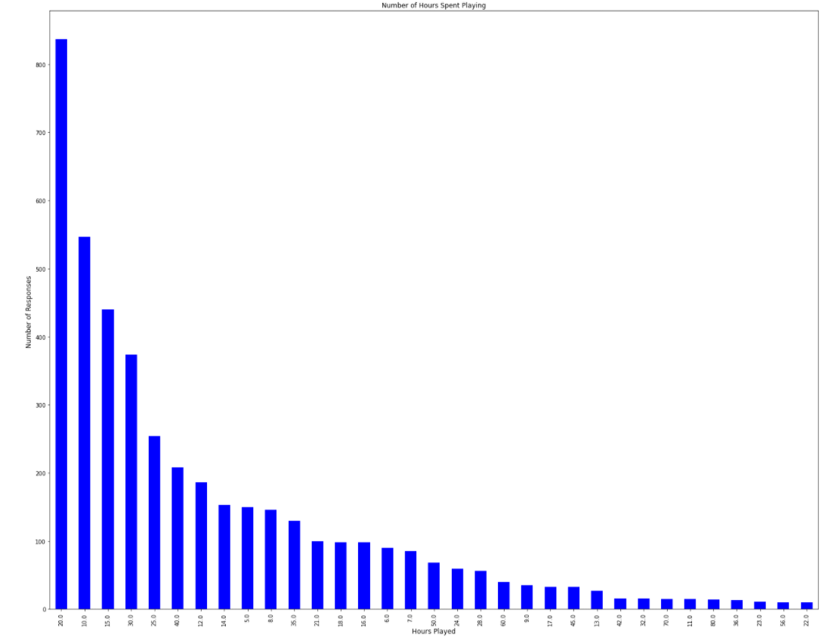
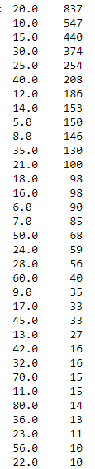
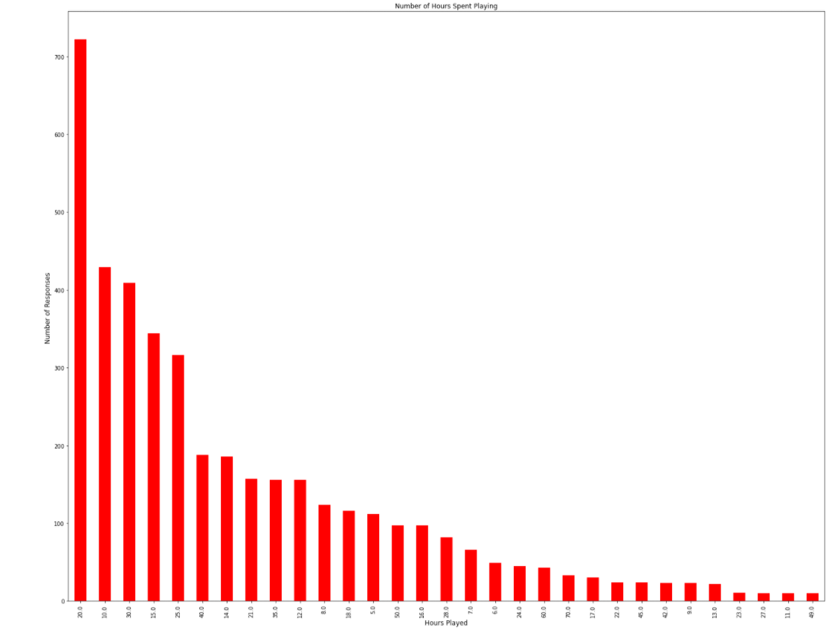
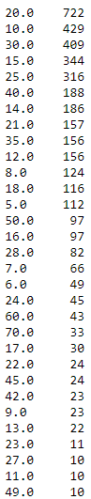
TIME PLAYED IN USA
TIME PLAYED OUTSIDE USA
Time Spent in Video Games

Slide 10
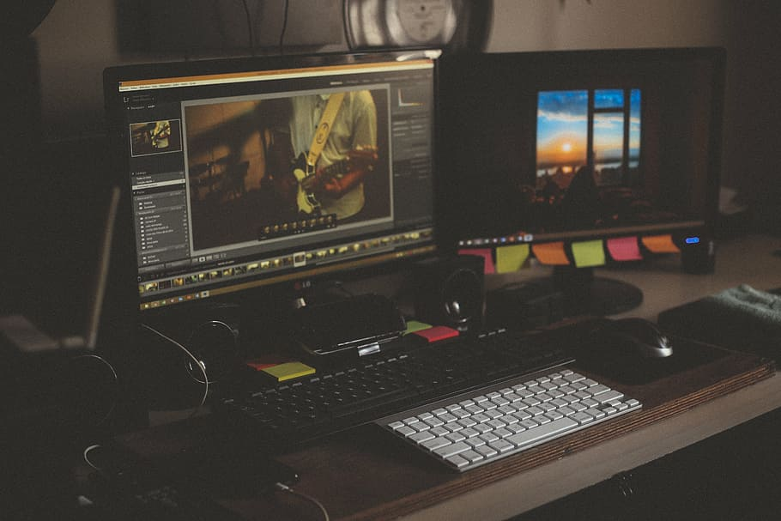
Now that we know WHAT we are playing….
Lets talk about what platforms we are on….
And see if our diagnoses have an effect

Slide 11
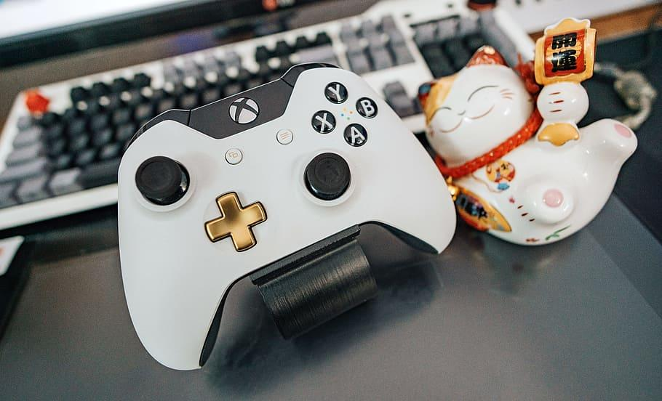

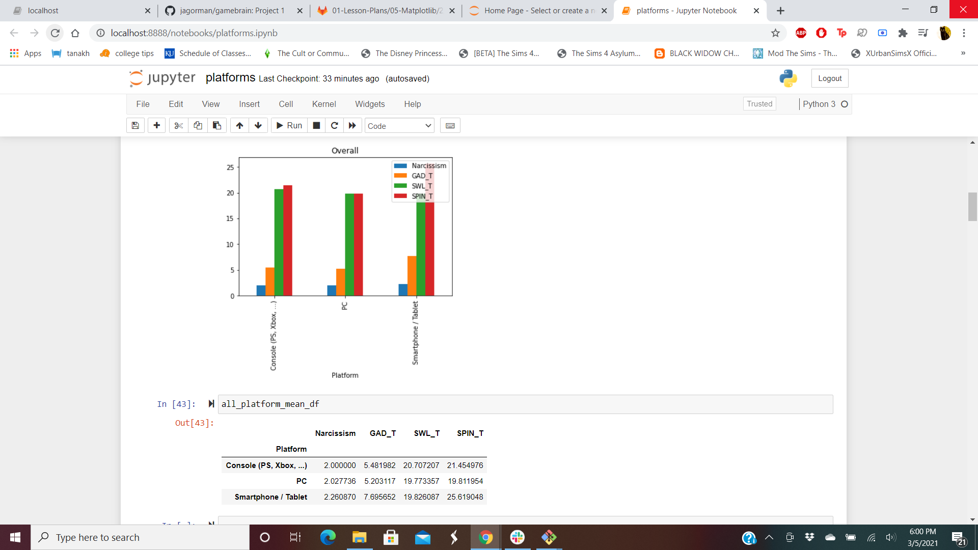
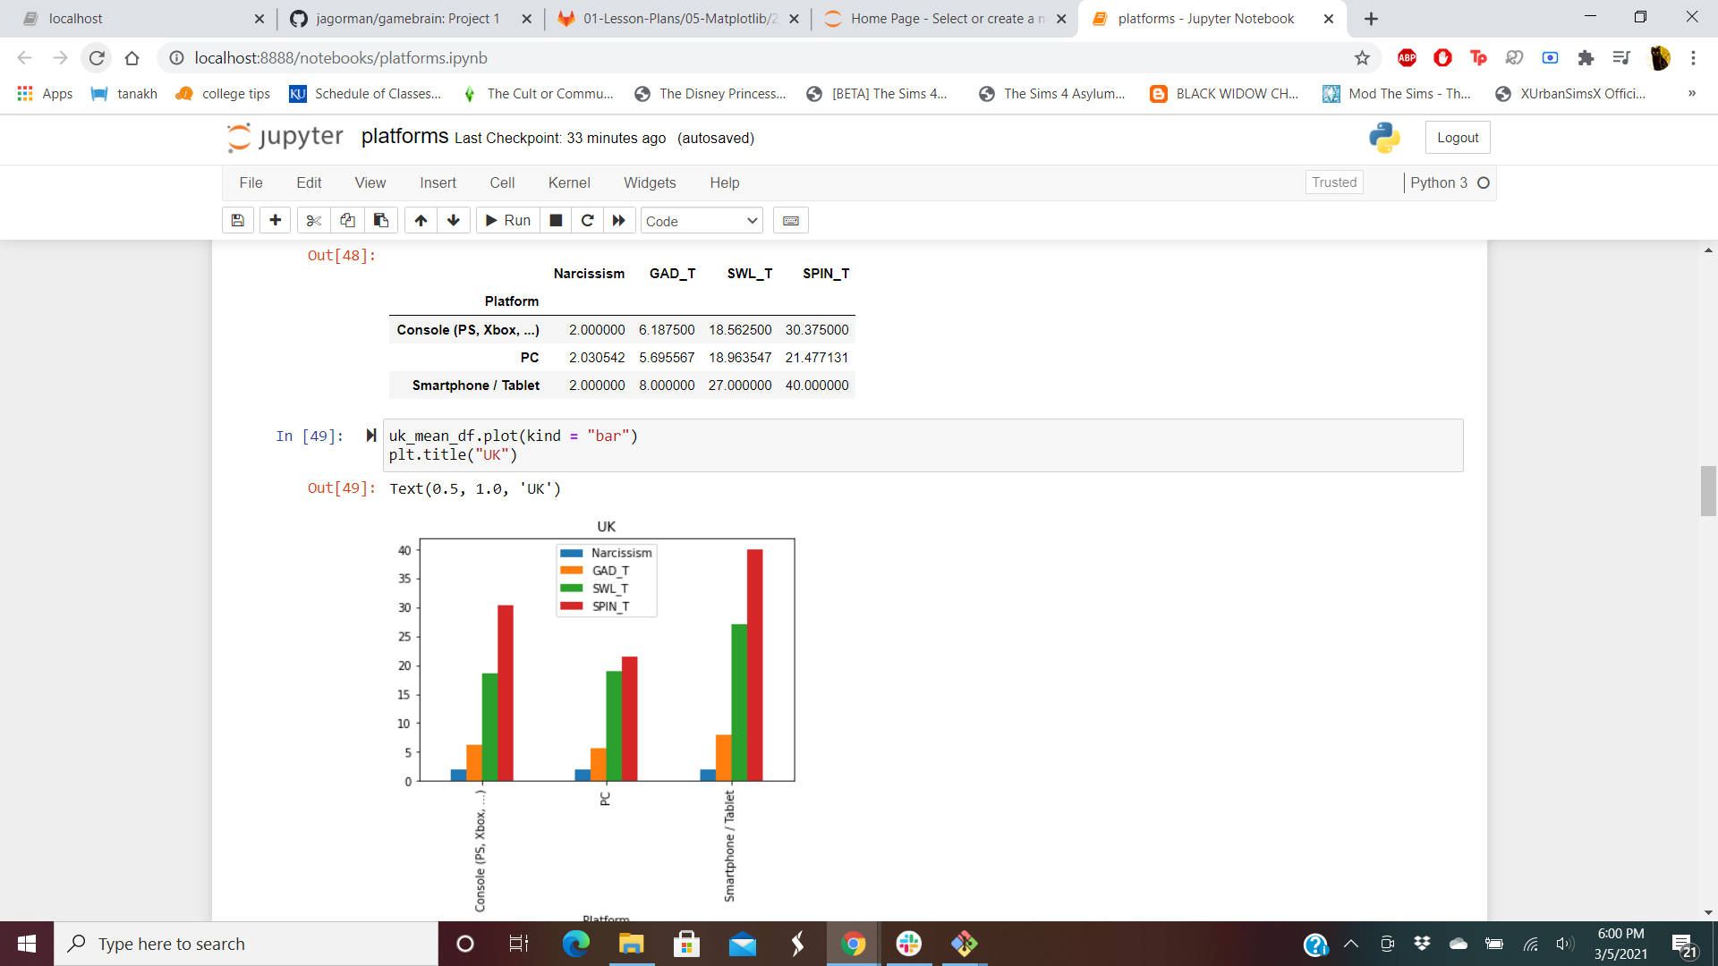
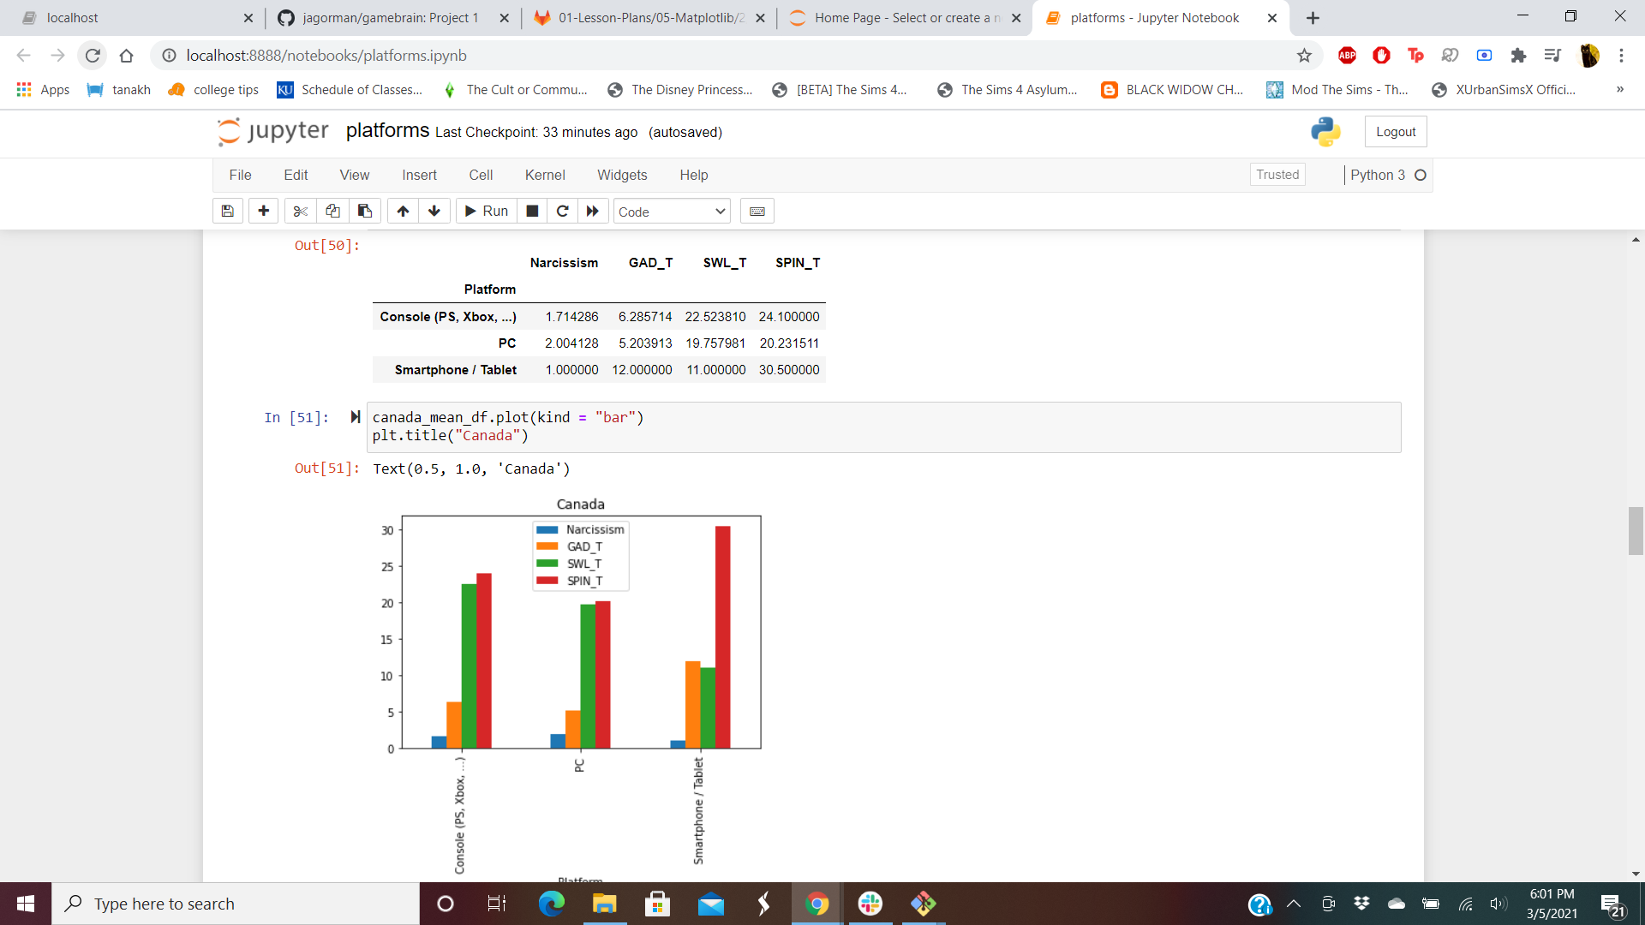
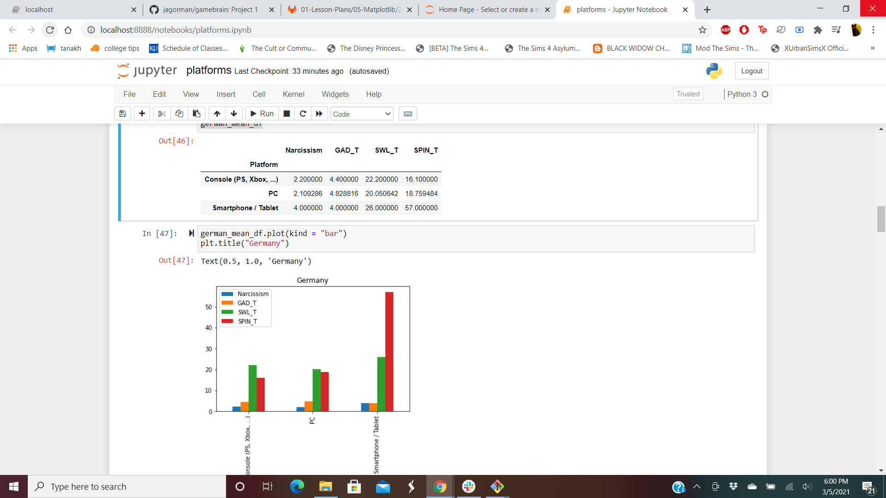
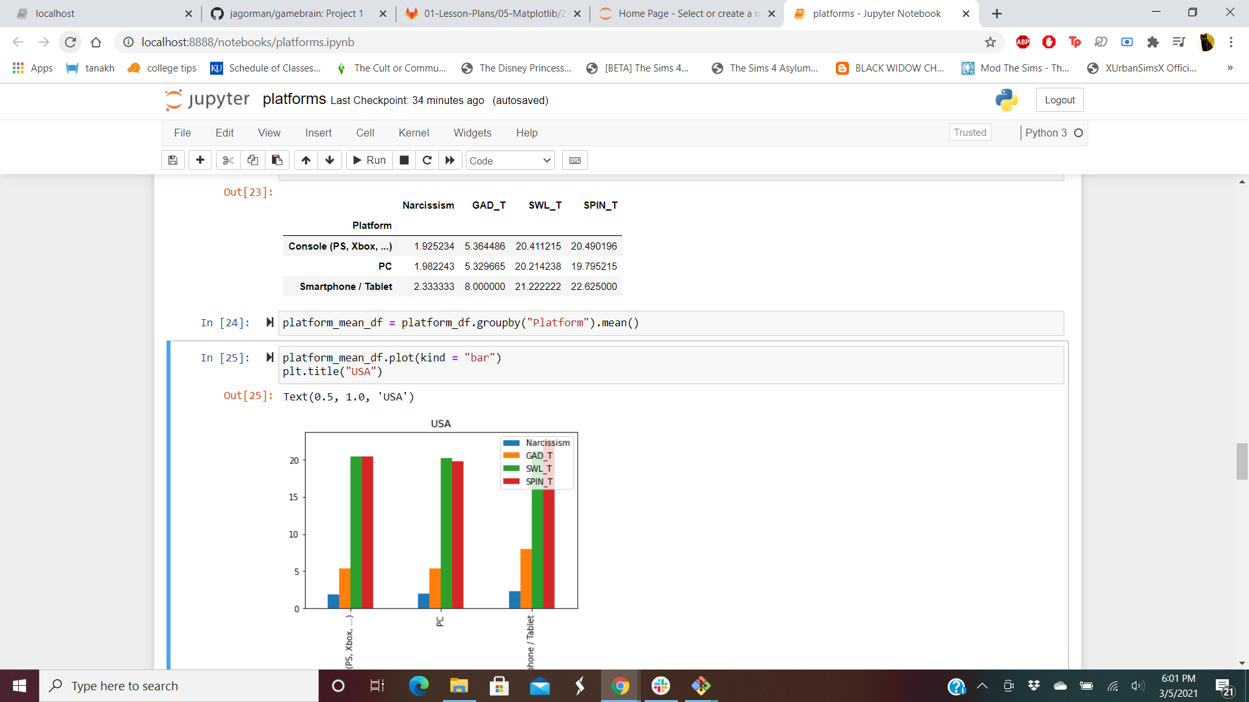
Notes:
34 seconds, click to show overall platform
1:04 seconds click once to vanish overall and load Germany
1:40 seconds, click to vanish Germany and load UK
1:57 seconds, click to vanish UK and load Canada
2:26 seconds, click to vanish Canada and load US

Slide 12
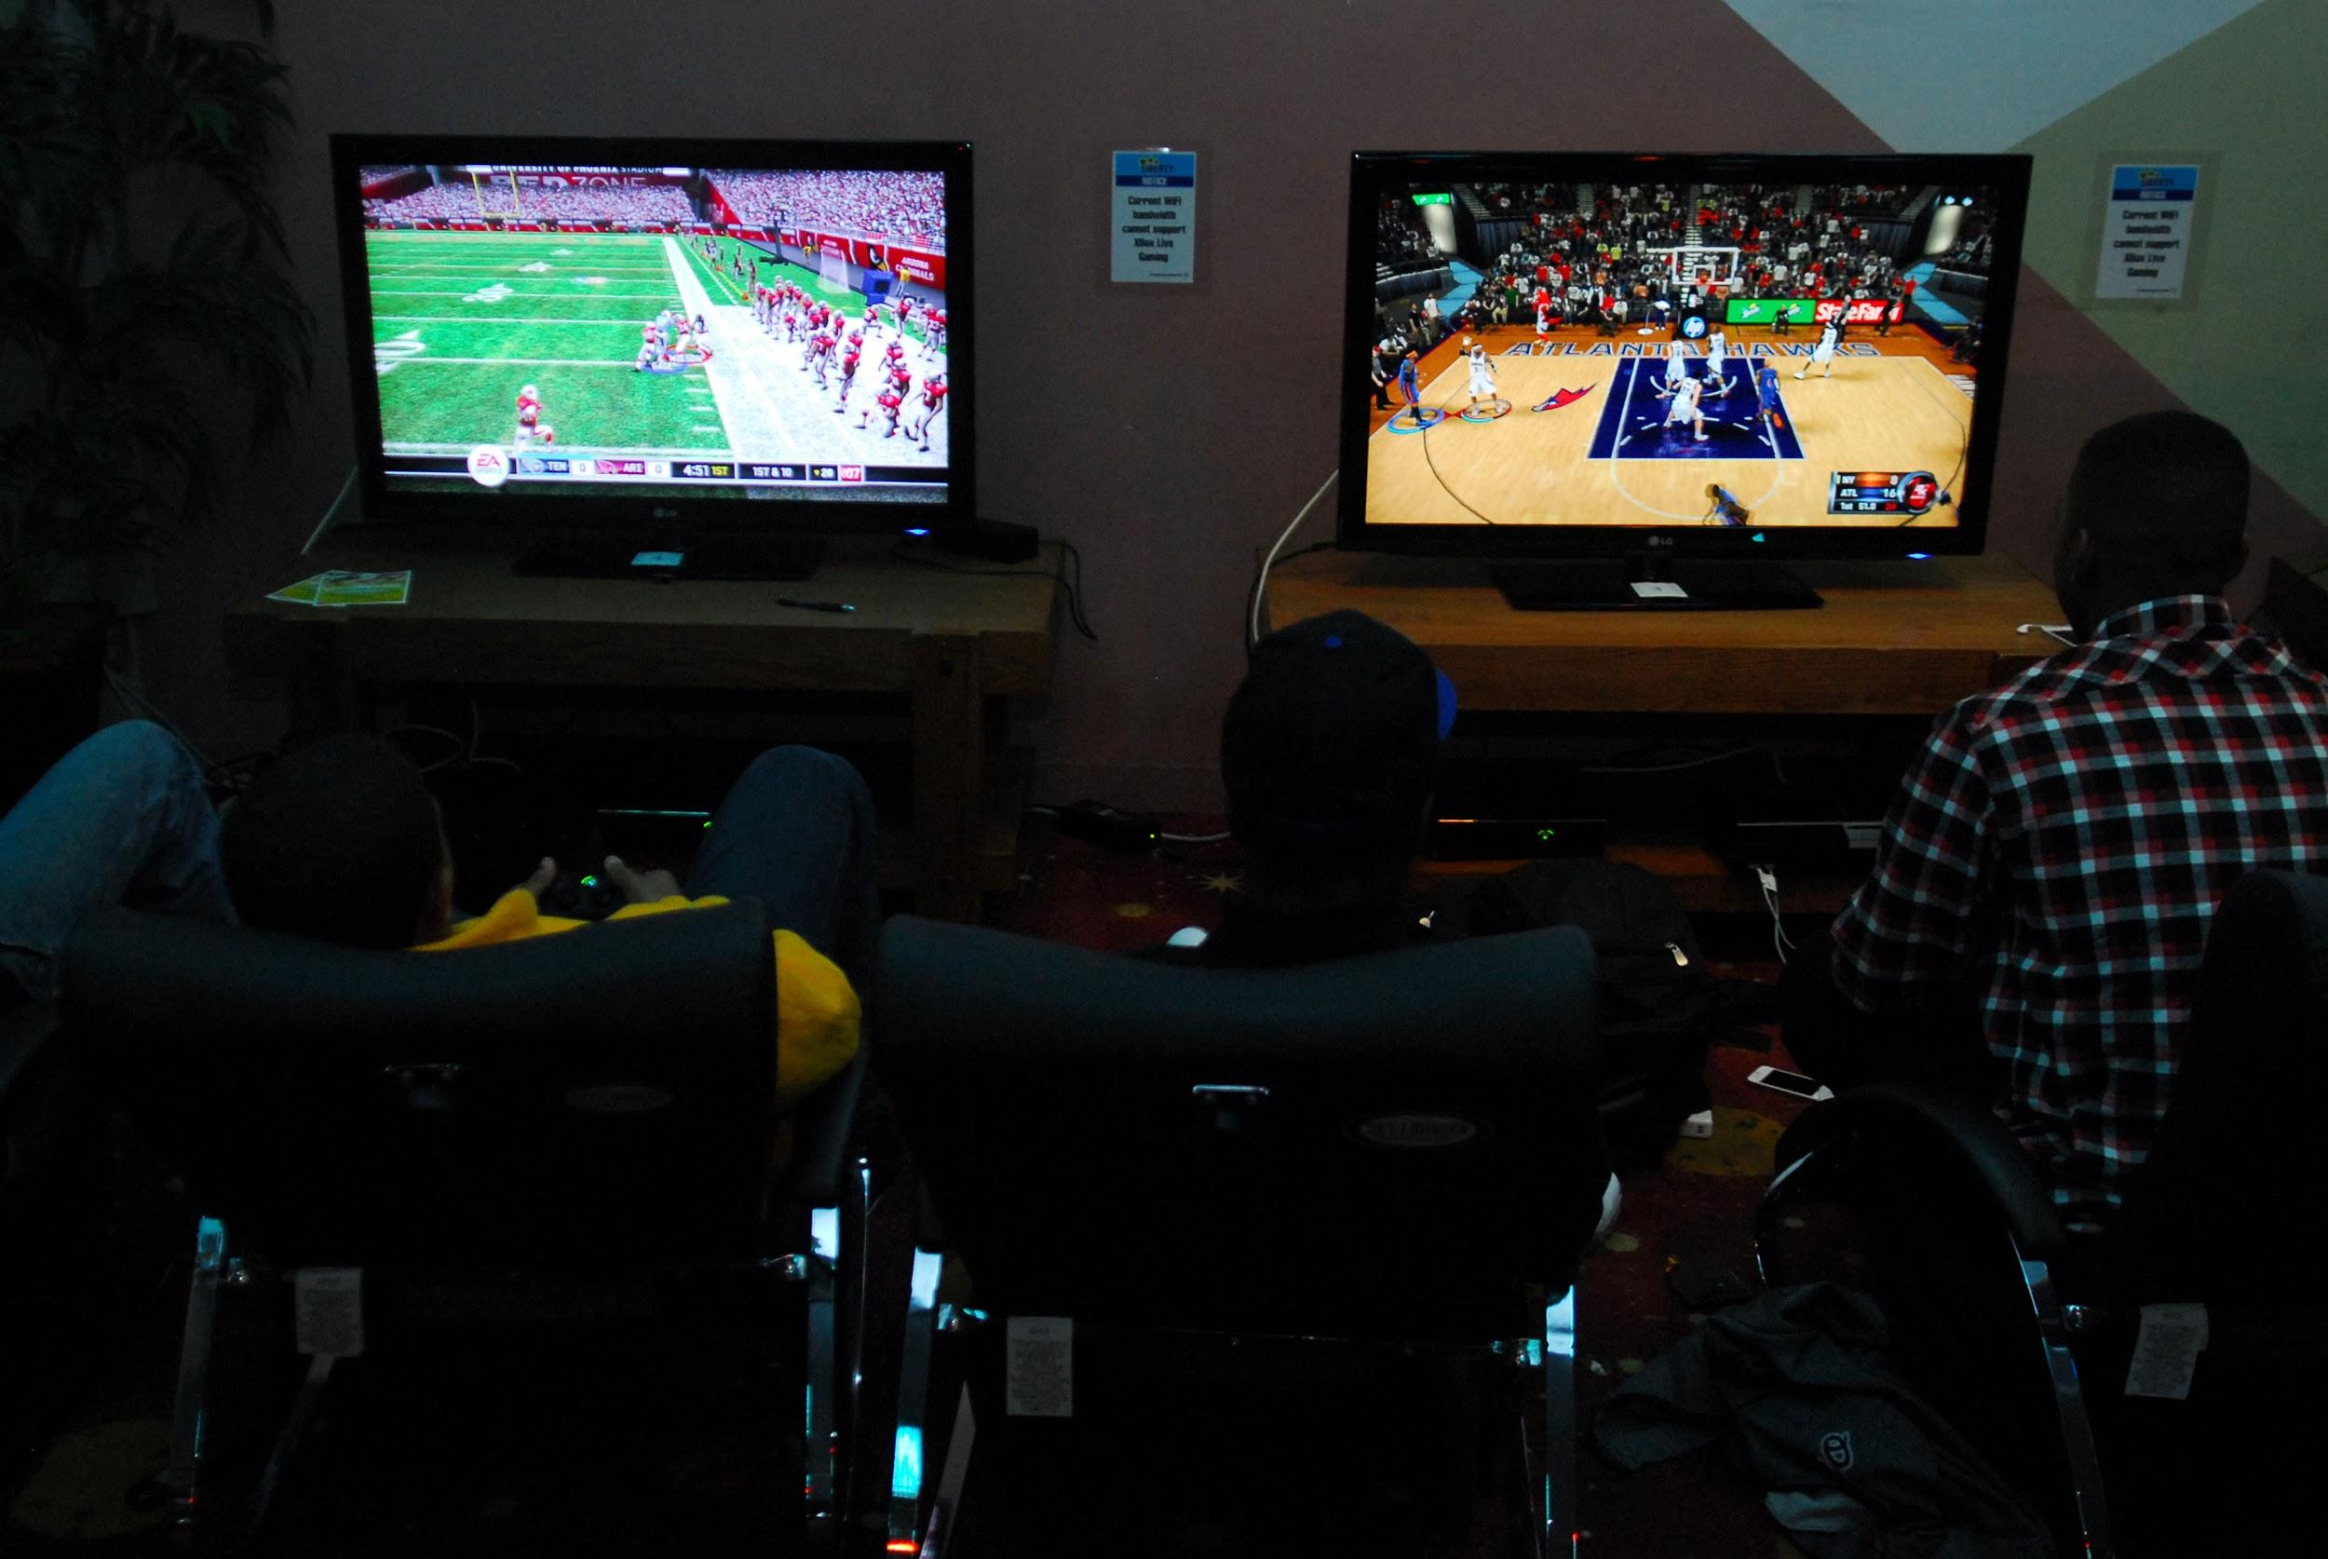
Does our gender and mental health affect WHY we play?

Slide 13

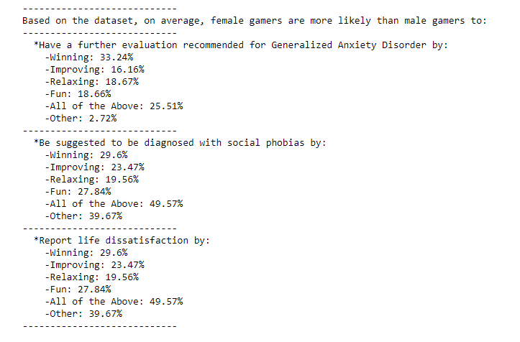
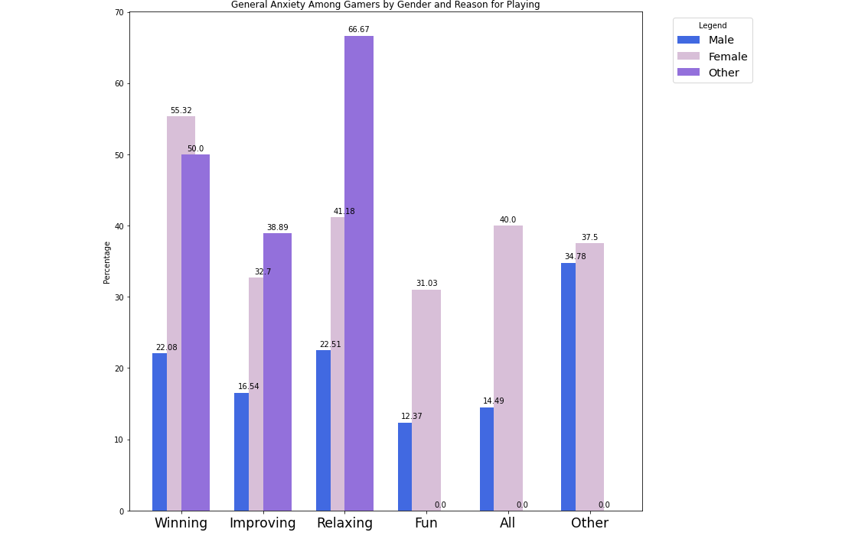
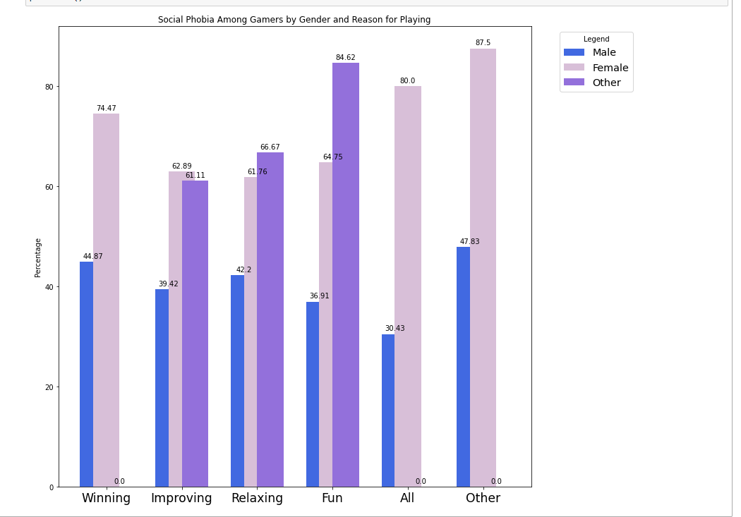
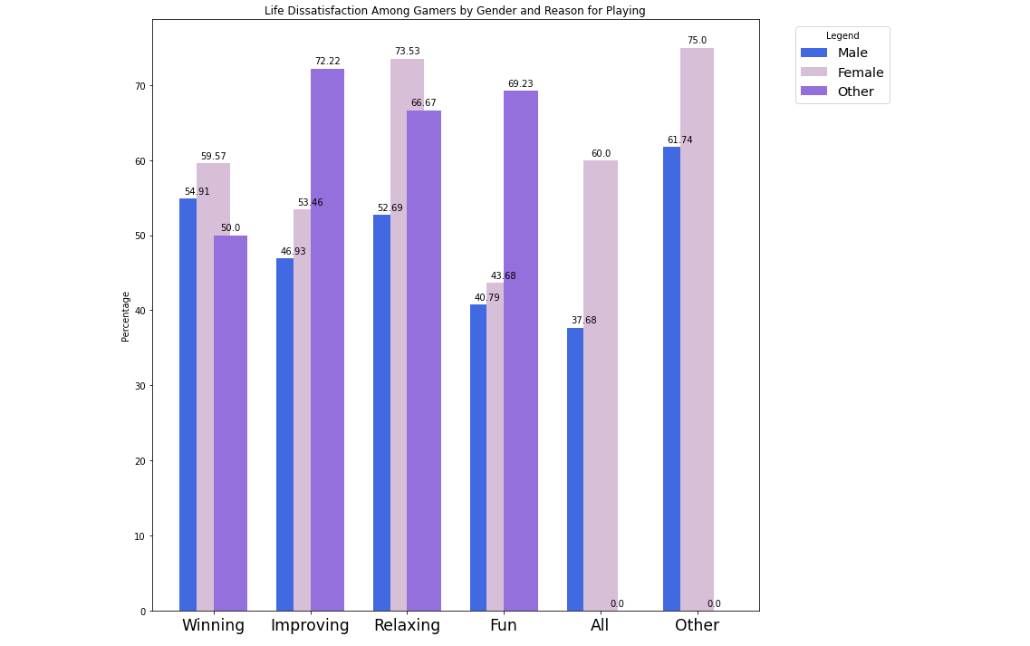

Slide 14
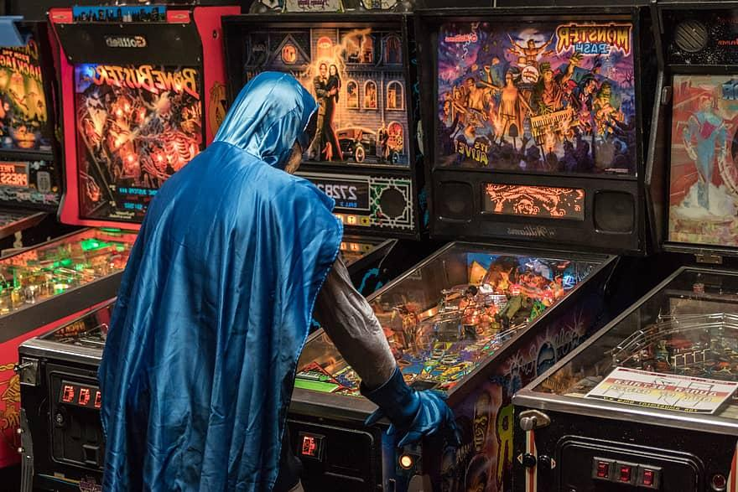
How do we play?

Slide 15
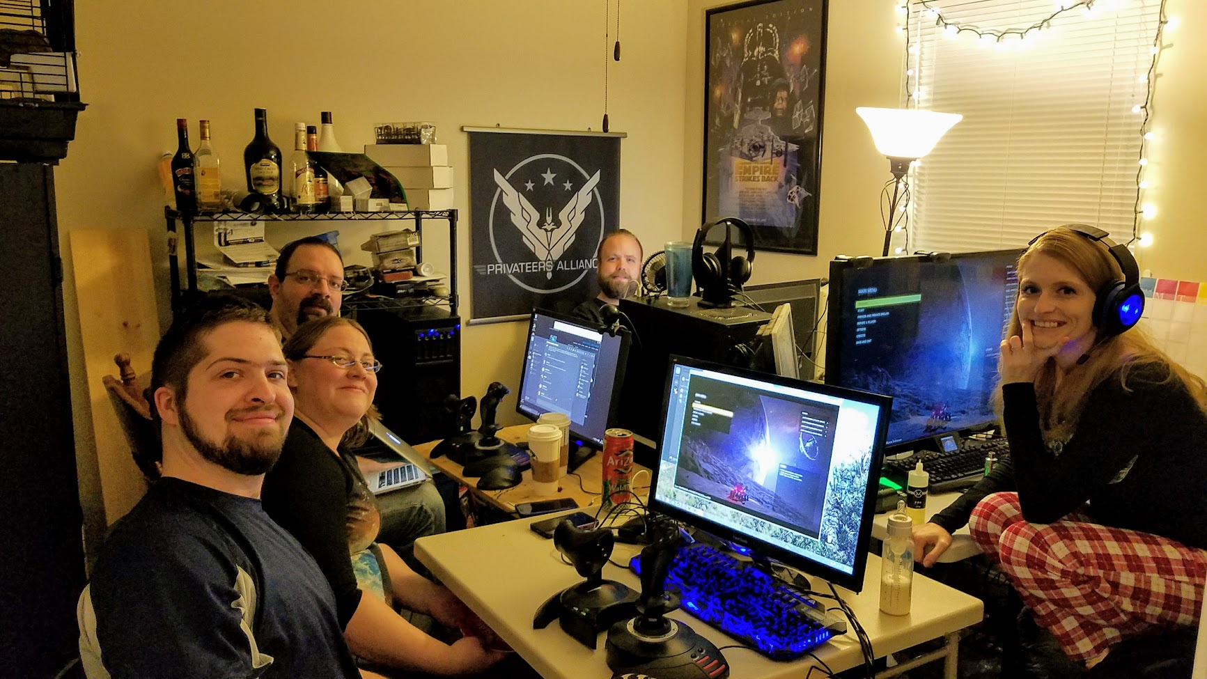
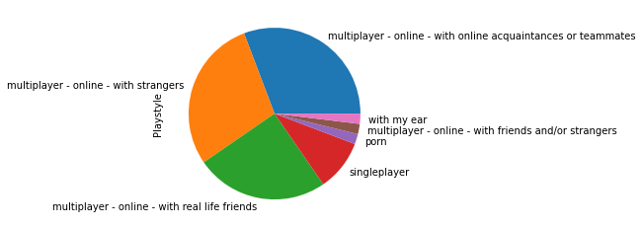
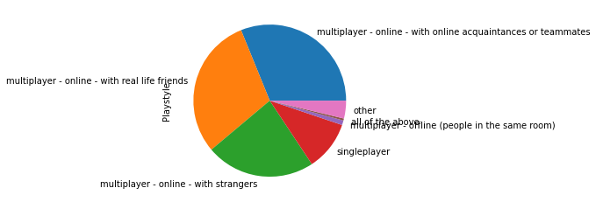
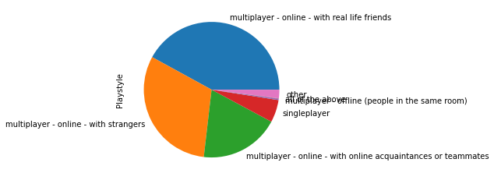
HOW DO WE PLAY?
Top Six Countries Total Playstyle
Female Playstyle
Other Playstyle
Male Playstyle

Slide 16

Does our mental health affect our playstyle?

Slide 17

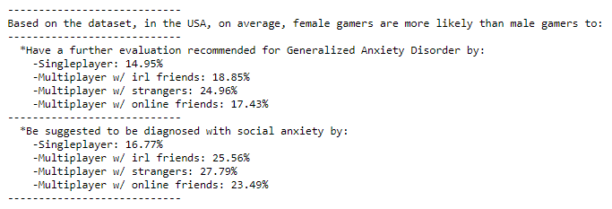
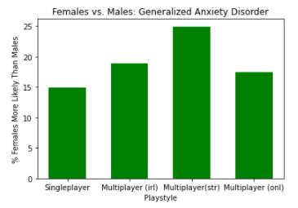
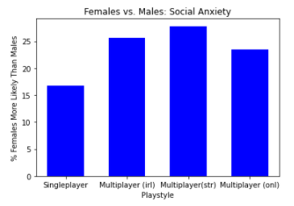

Slide 18

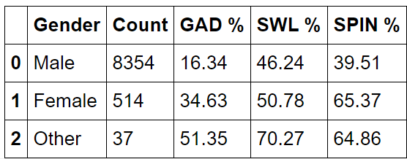
What diagnoses are most common in each gender?

Slide 19
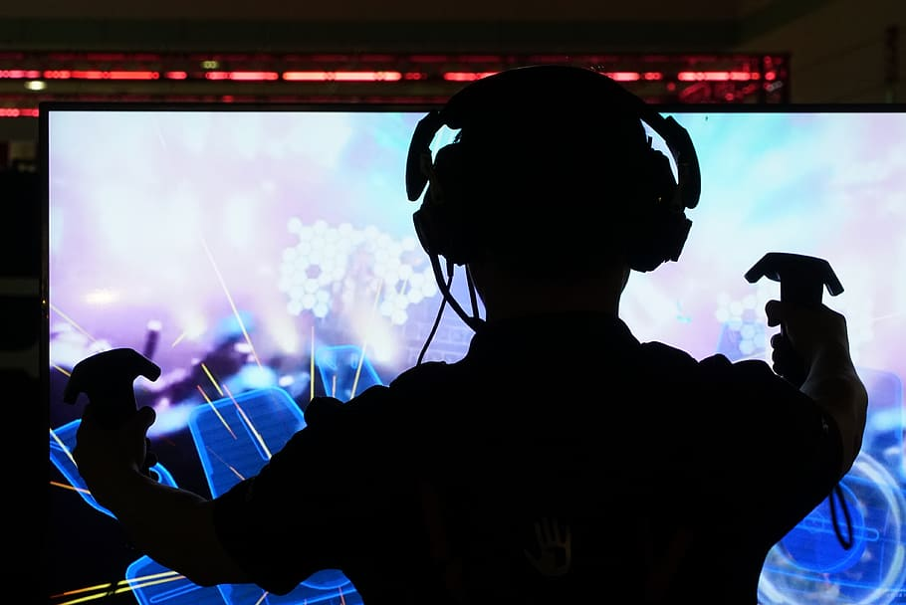
Final notes, observations,
questions

Slide 20
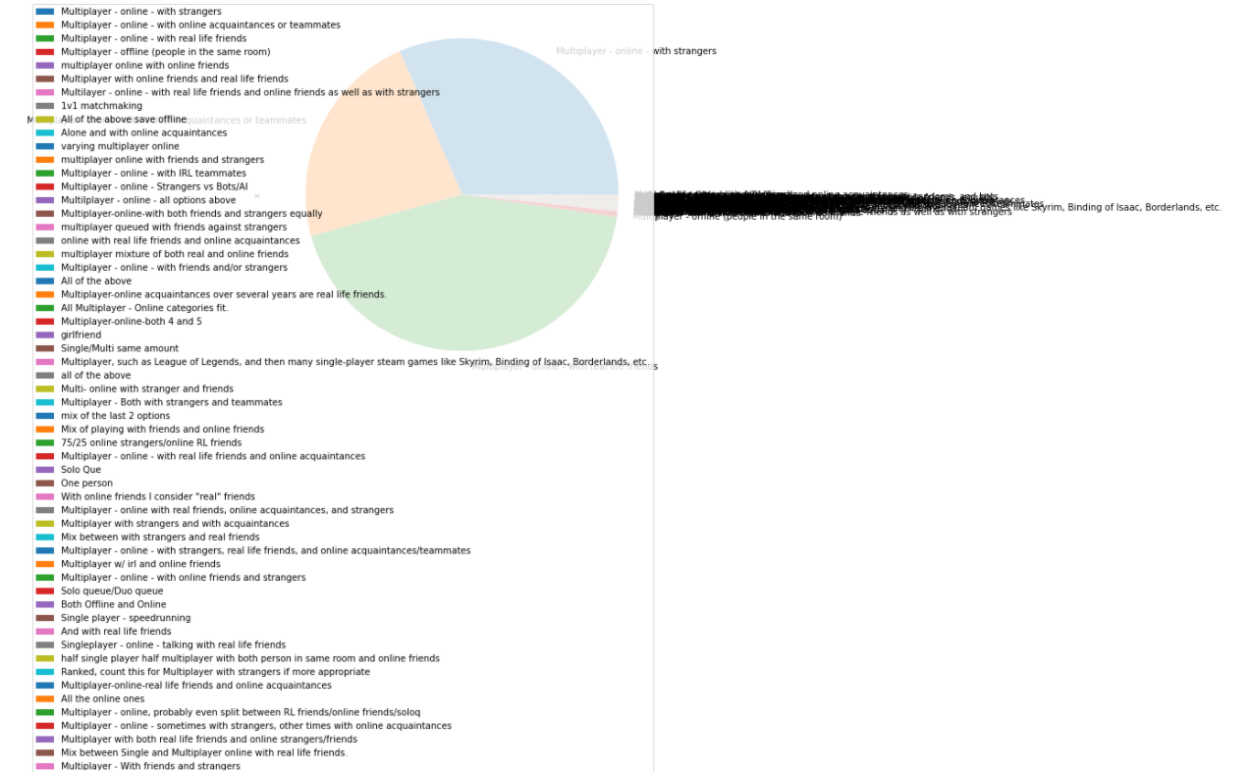
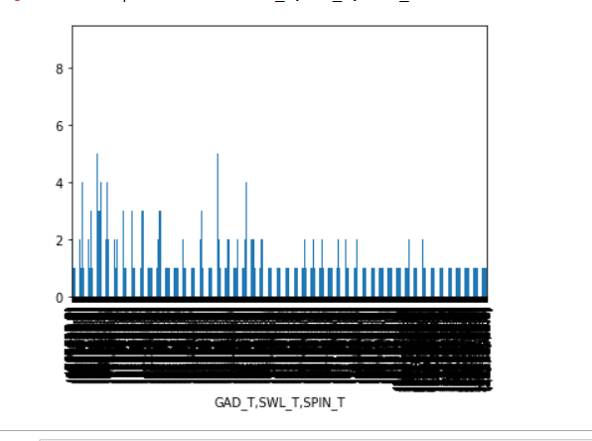
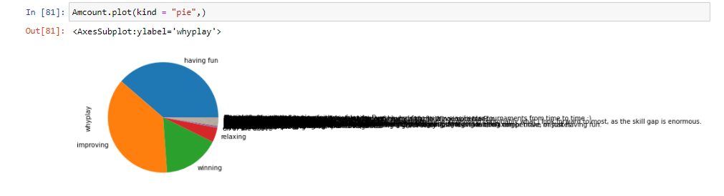
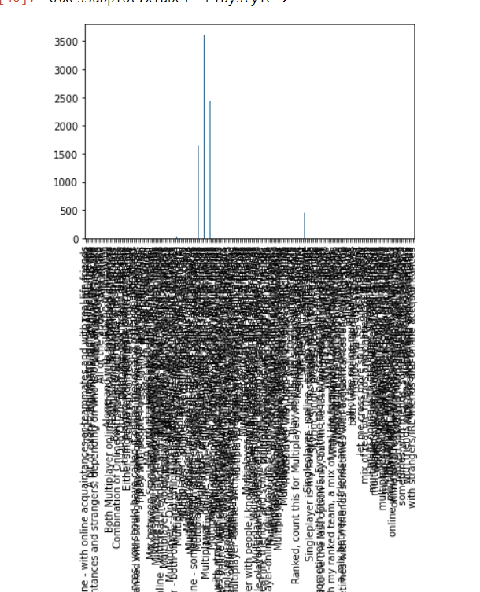
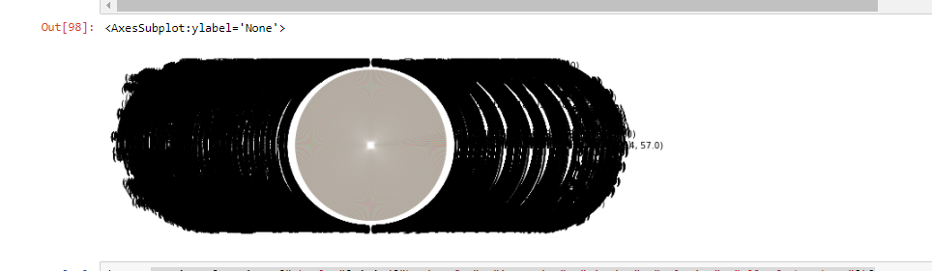
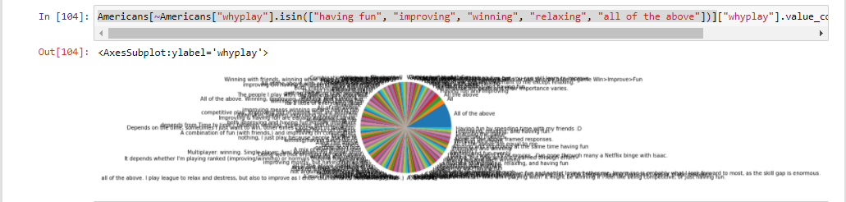
Bloopers

Slide 21
Credits
What Game and Time Played: Daniel Buescher
Platforms: Paige Breyfogle
Why Play?: Andrew Stepanek
Playstyle and Gender: J.A. Gorman
Playstyle, Gender, Diagnosis: Ian Arch
Slideshow created by: J.A. Gorman

